Slide 1
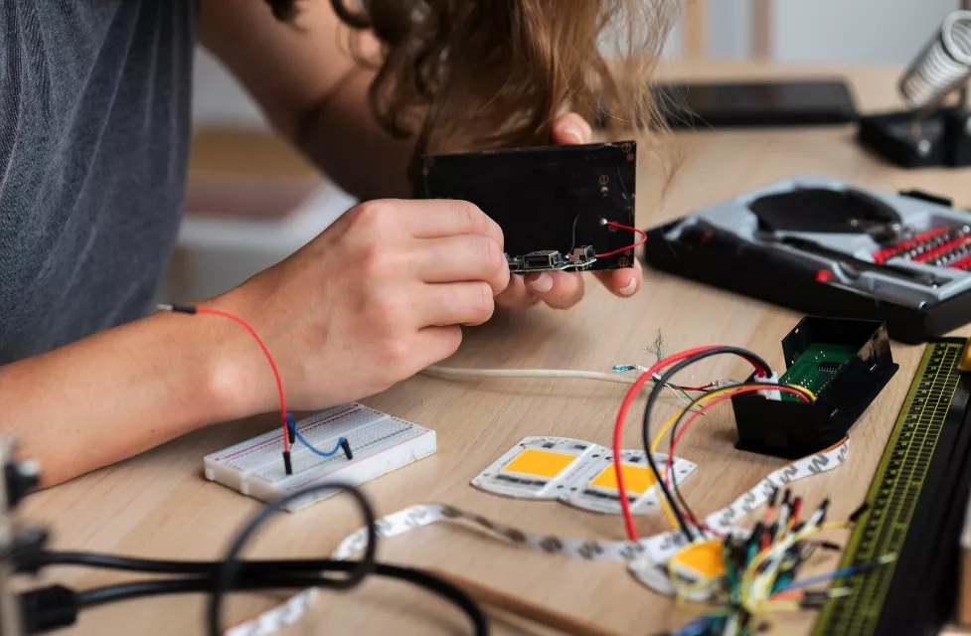
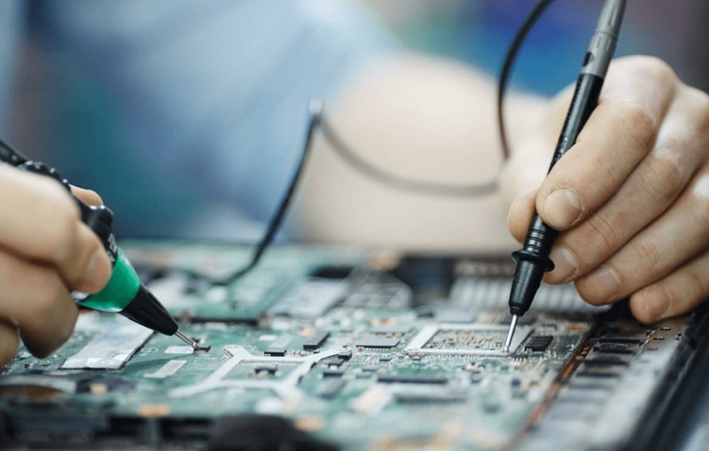
Open Session #1

Slide 2
Do anything!
Ideally practice and be comfortable with our previous lessons
There are other projects attached to the classroom post and on the next slide that may be more interesting/more of a challenge

Slide 3
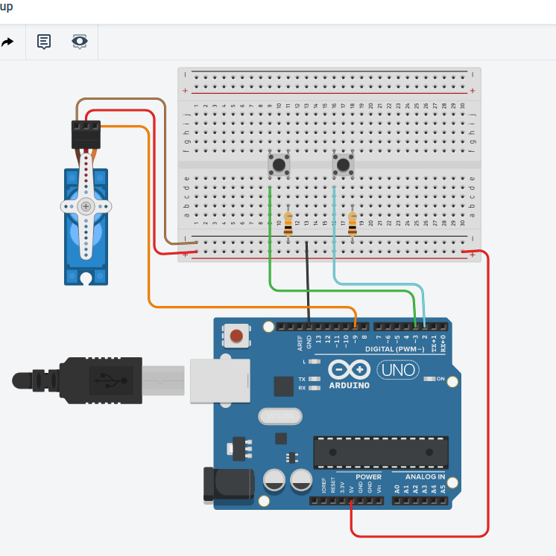
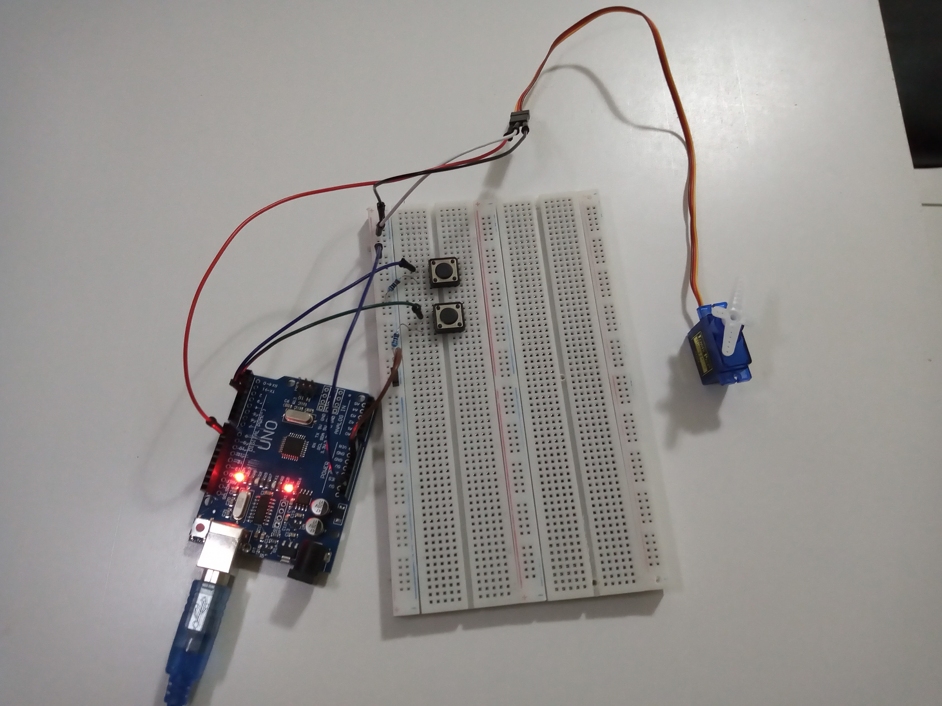
Controlling servo motors with buttons and arduino

